Slide 1

How does hyporheic flow affect fine sediment deposition? Field data analysis (so far)
What I have been working on these past two months!

Slide 2
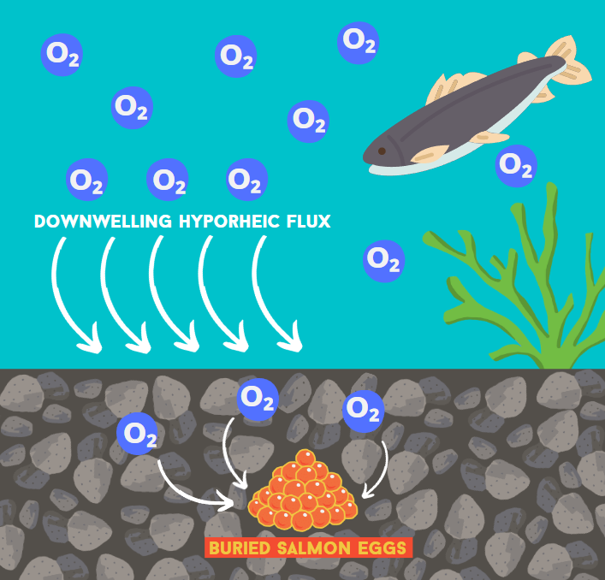
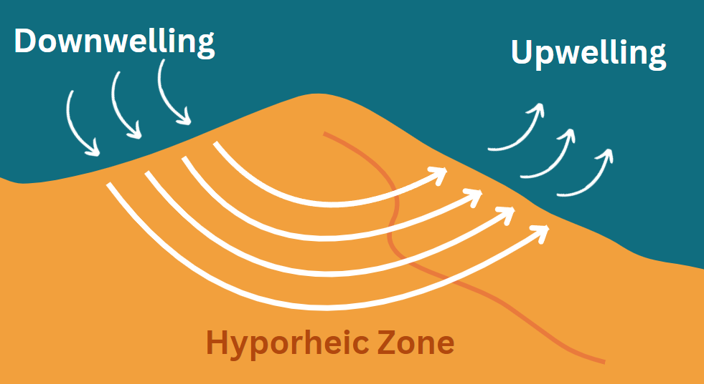
Introduction
Hyporheic flux is induced by pressure differentials, causing water to come in and out of the stream
Hyporheic zone is the interface between the bed river and surface water
1

Slide 3
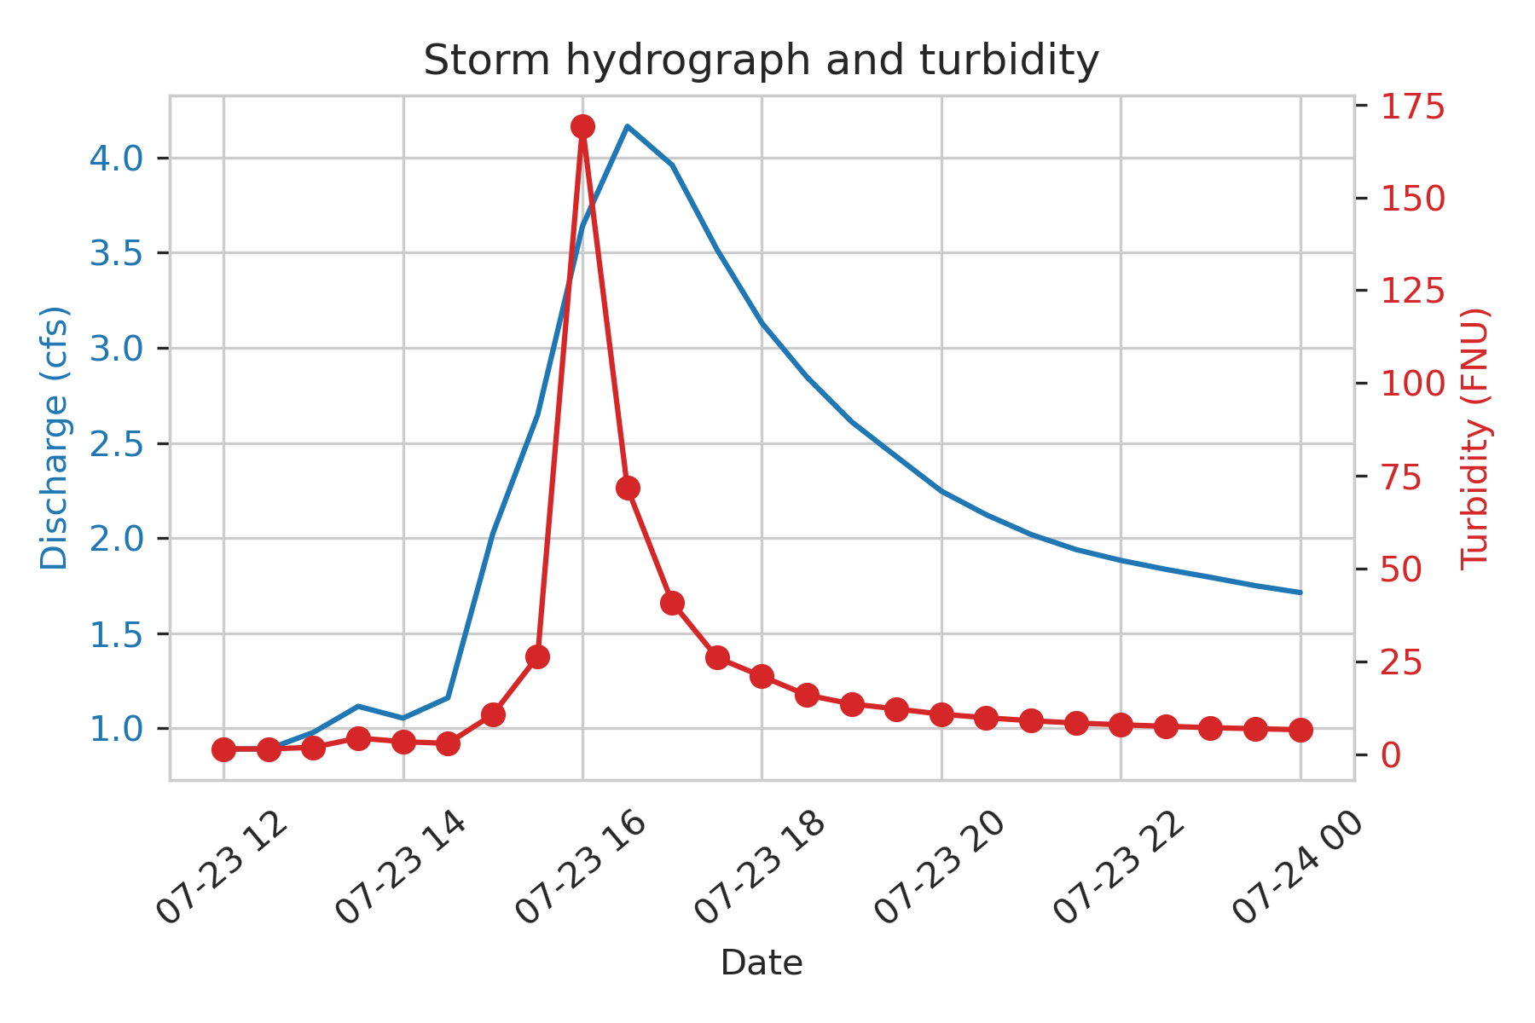
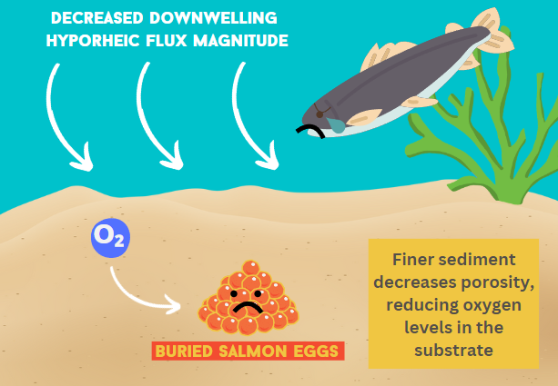
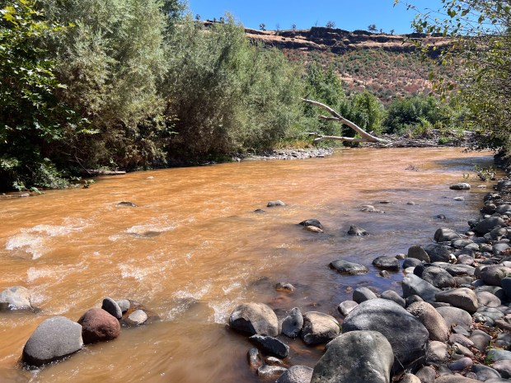
Introduction
During high flow events, fine sediment is transported and later deposited into the riverbed. This can be detrimental for riverine health and aquatic habitat
2

Slide 4
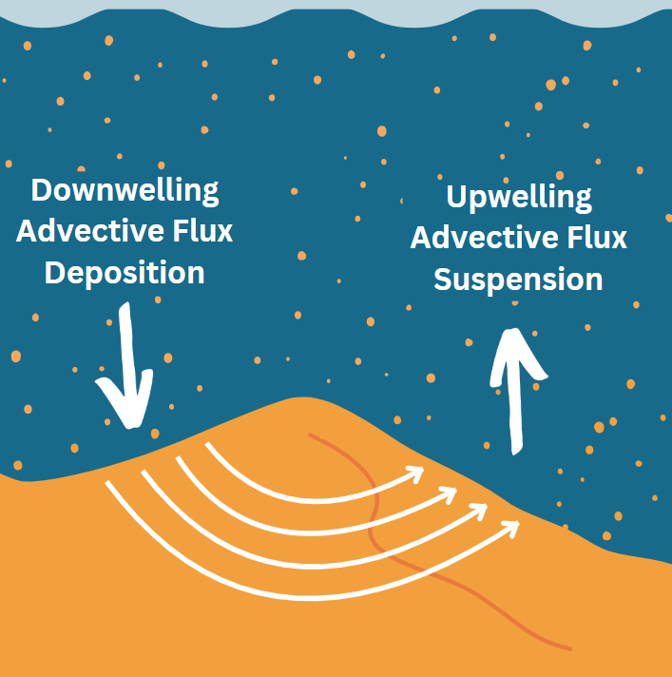
Introduction
More fine sediment deposition can occur in areas with losing conditions
Deposition in terms of particle size?
I believe that downwelling areas will have more fine sediment concentrations and a finer PSD than gaining reaches
To answer these questions, I will be using field data that I have been collecting since 2021
3

Slide 5
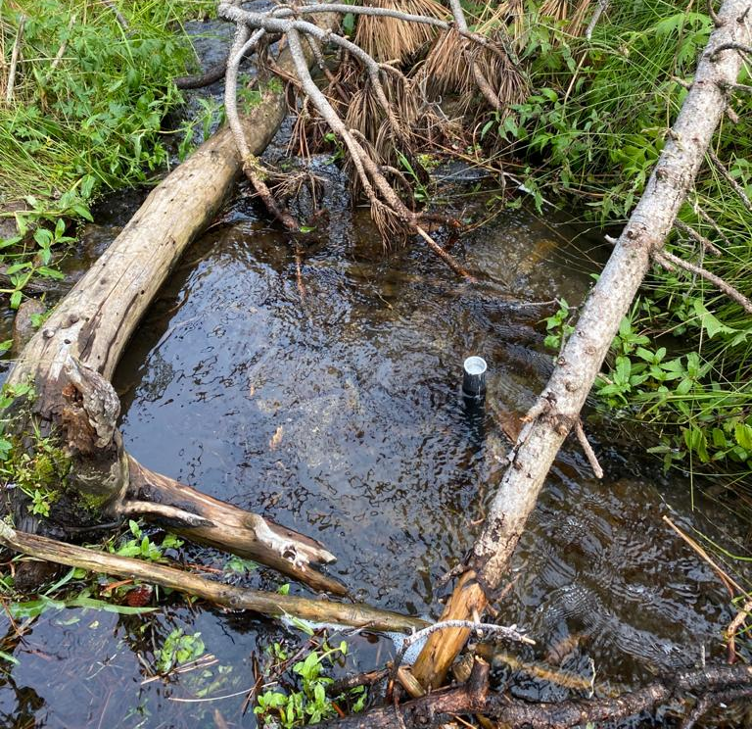
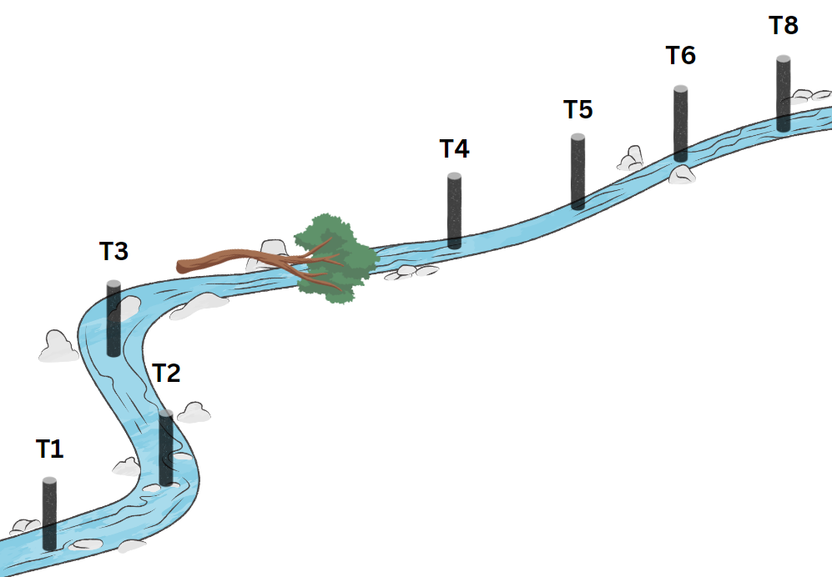
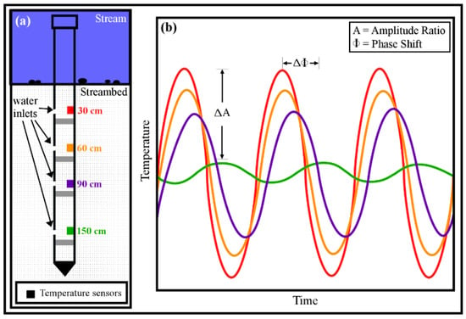
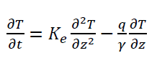
Methods: Calculating hyporheic flux
Eight temperature probes were installed into the streambed in 2021
To solve the advection-diffusion equation
T = Temperature (°C)
t = Time (s)
Ke = Thermal diffusivity (m2/s)
z = Depth into the streambed (m)
q = Darcinian flux (m/s)
γ = Ratio between the heat capacity of the sediment and heat capacity of water.
4

Slide 6
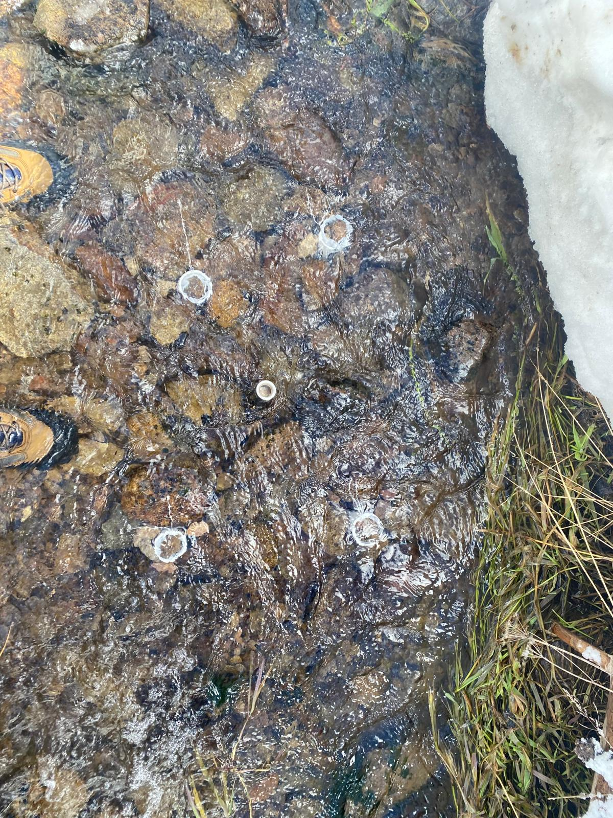
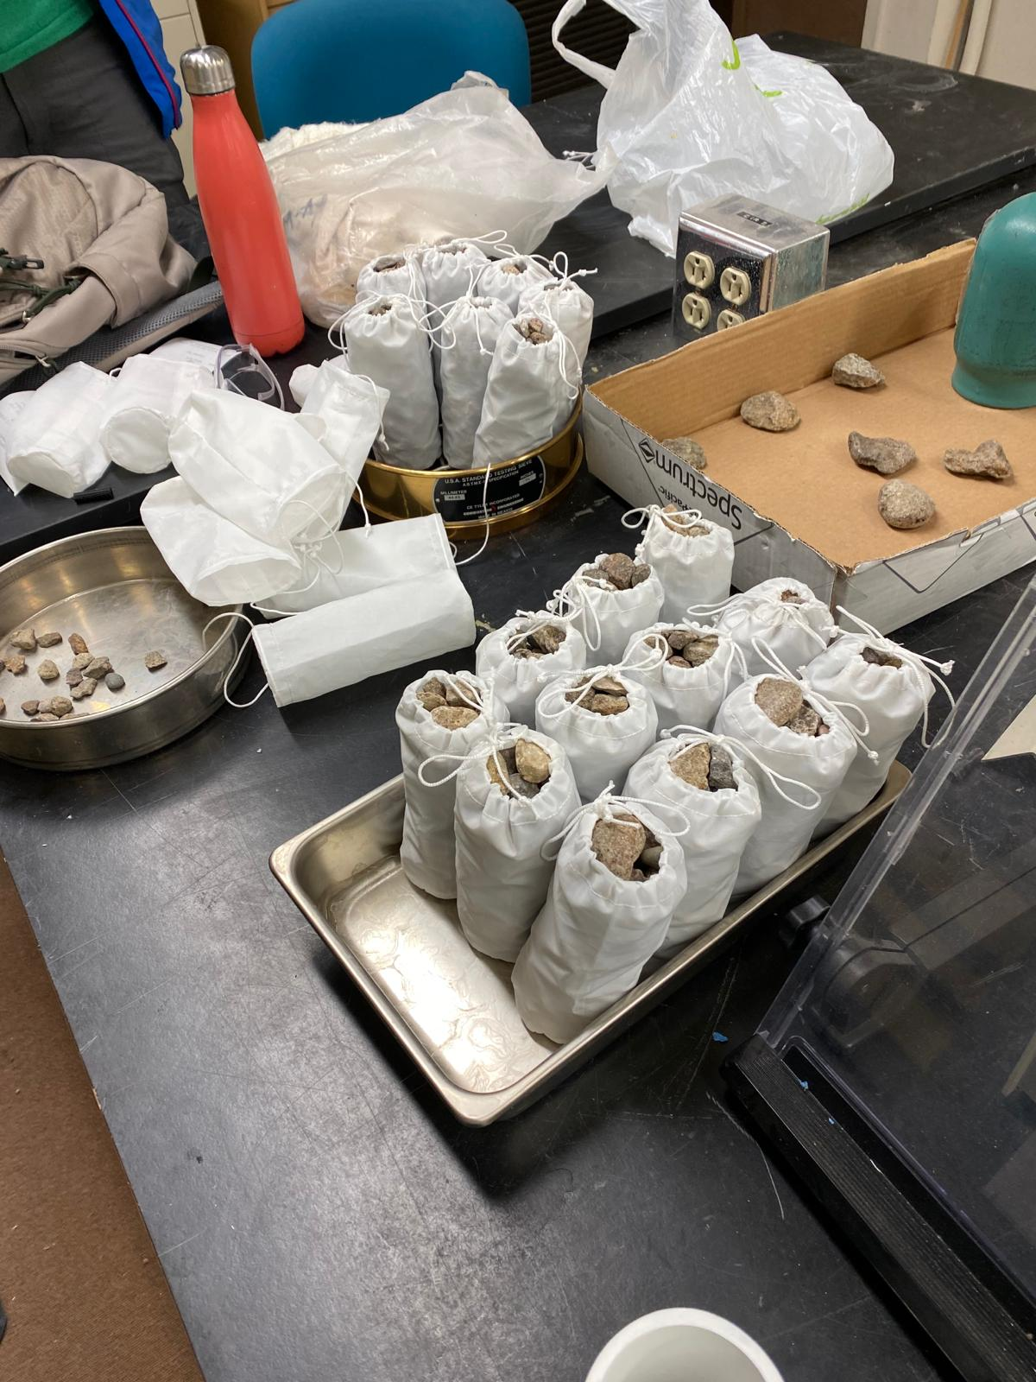
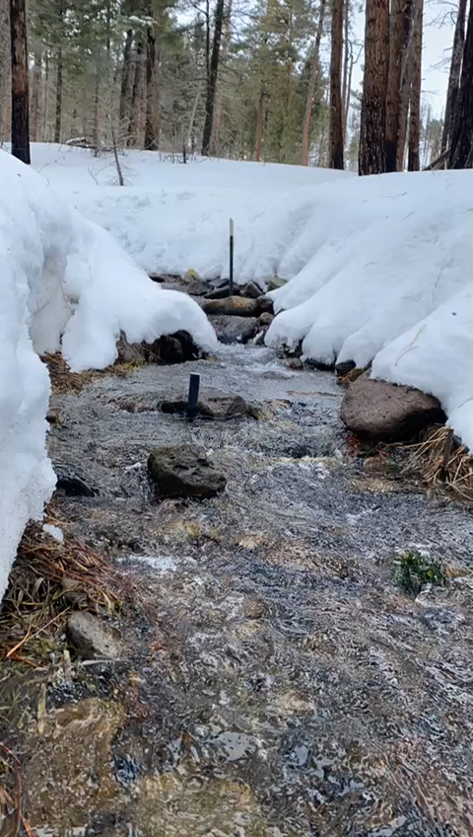
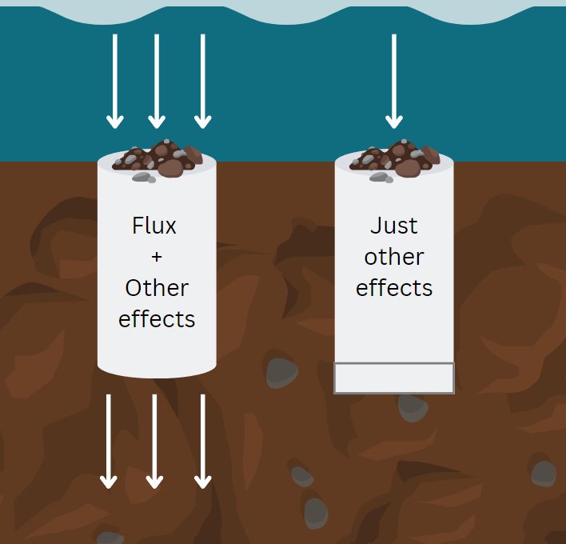
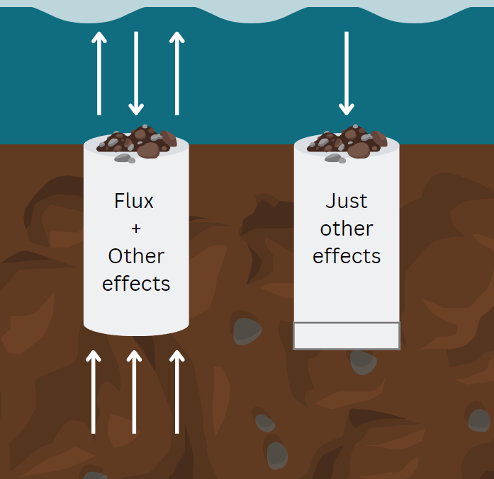
Methods: Fine sediment PSD
Data collection and field work
Downwelling Conditions
Upwelling Conditions
5

Slide 7
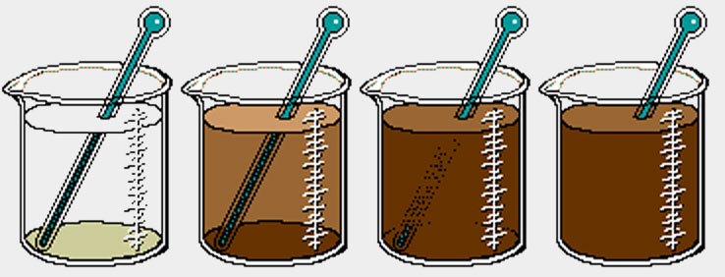
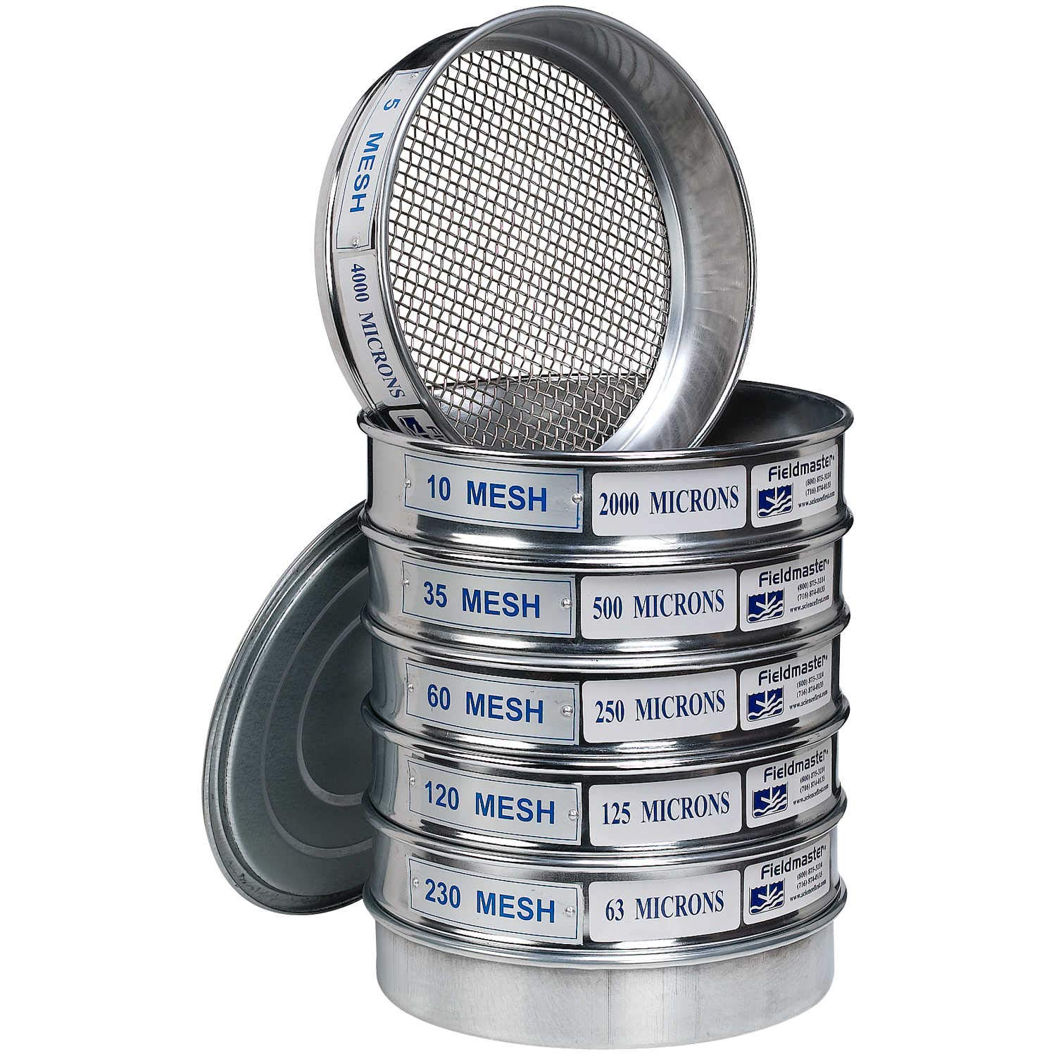
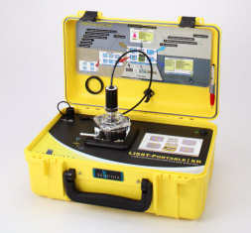
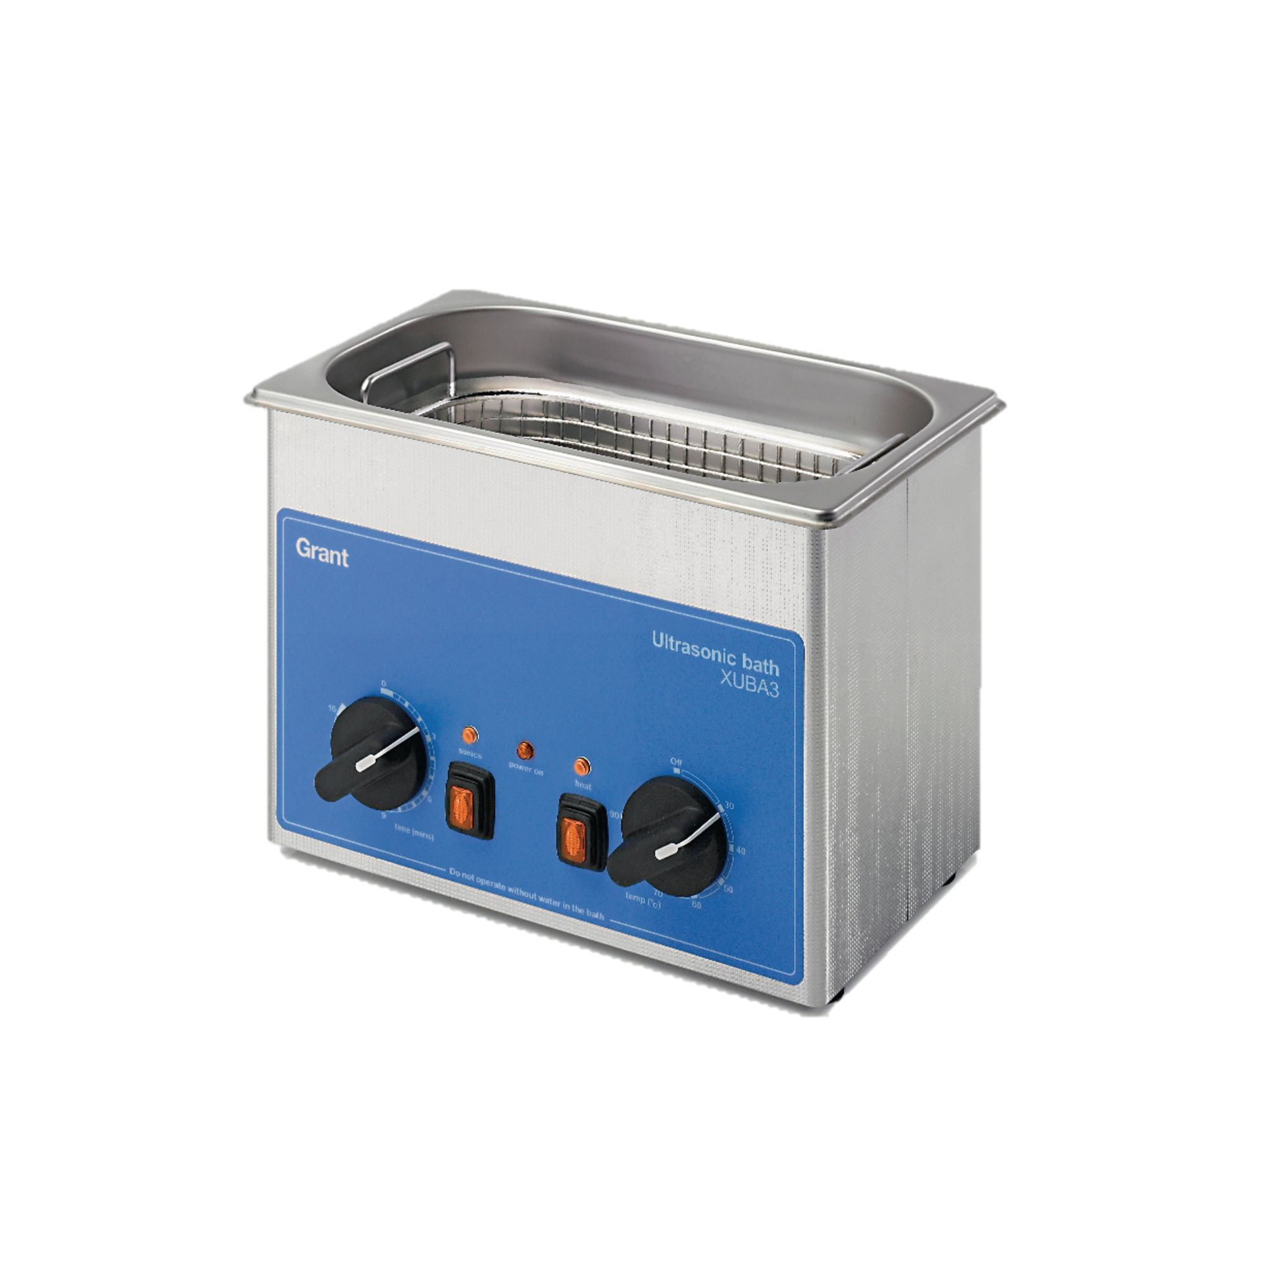

Methods: Fine sediment PSD
Laboratory work and sample processing
A & D = Open
B & C = Closed
Samples are dry sieved
0.1g of sediment was diluted into 500 mL of water
LISST portable XR for sediment < 500 µm
Laser In Situ Scattering Transmissometer
6

Slide 8
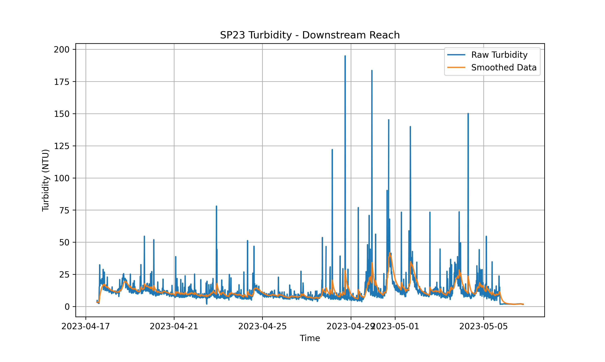
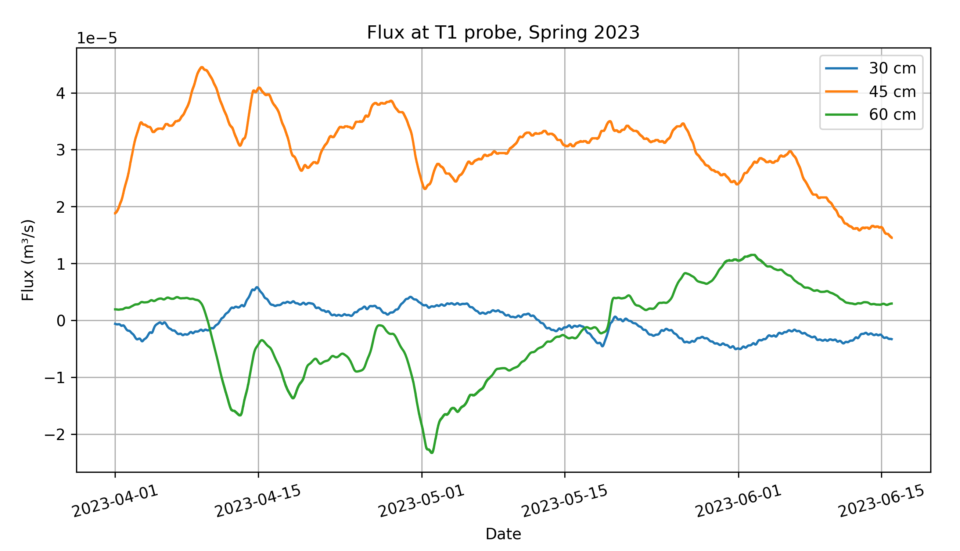
Results: Spring 2023
Initially compared my PSD of each basket to the full seasonal hyporheic flux average but didn’t get a good correlation. I decided to average through the periods of high turbidity, since this is when sediment is in suspension.
Smoothed using an exponential moving average
4/28 to 5/5
7

Slide 9
Results: Spring 2023 – D50
Preliminarily, open baskets correlate better to grain size than the closed baskets, and the direction of the slope is what we had expected!
8

Slide 10
Results: Spring 2023: Total Sediment Weight
Same for the total sediment weight, where we see more fine sediment at downwelling locations than in upwelling for the open baskets.
Considerable scatter for the closed baskets (other effects taking place)
9

Slide 11
Results: Spring 2023: Other percentiles
Closed Baskets
Percentile | R2 | slope
10 | 0.2964 | 0.7012
16 | 0.2387 | 0.8853
40 | 0.0914 | 1.4468
50 | 0.0846 | 2.0064
60 | 0.0884 | 2.9955
84 | 0.114 | 7.8814
Open Baskets
Percentile | R2 | slope
10 | 0.2795 | 0.572
16 | 0.3847 | 1.3939
40 | 0.2958 | 4.8181
50 | 0.231 | 5.6542
60 | 0.2532 | 8.0782
84 | 0.2504 | 14.918
10

Slide 12
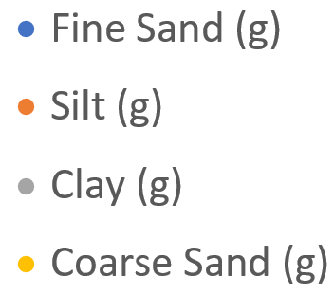
Results: Spring 2023: Size class weights
ISSS/IUSS
Category | Size Range (mm)
Gravel | >2.0
Coarse Sand | 0.2-2
Fine Sand | 0.02-0.2
Silt | 0.002-0.02
Clay | <0.002
The LISST will only give PSD in terms of cumulative concentrations, so I used the weights from my dry sieved data to have it them in weight
11

Slide 13
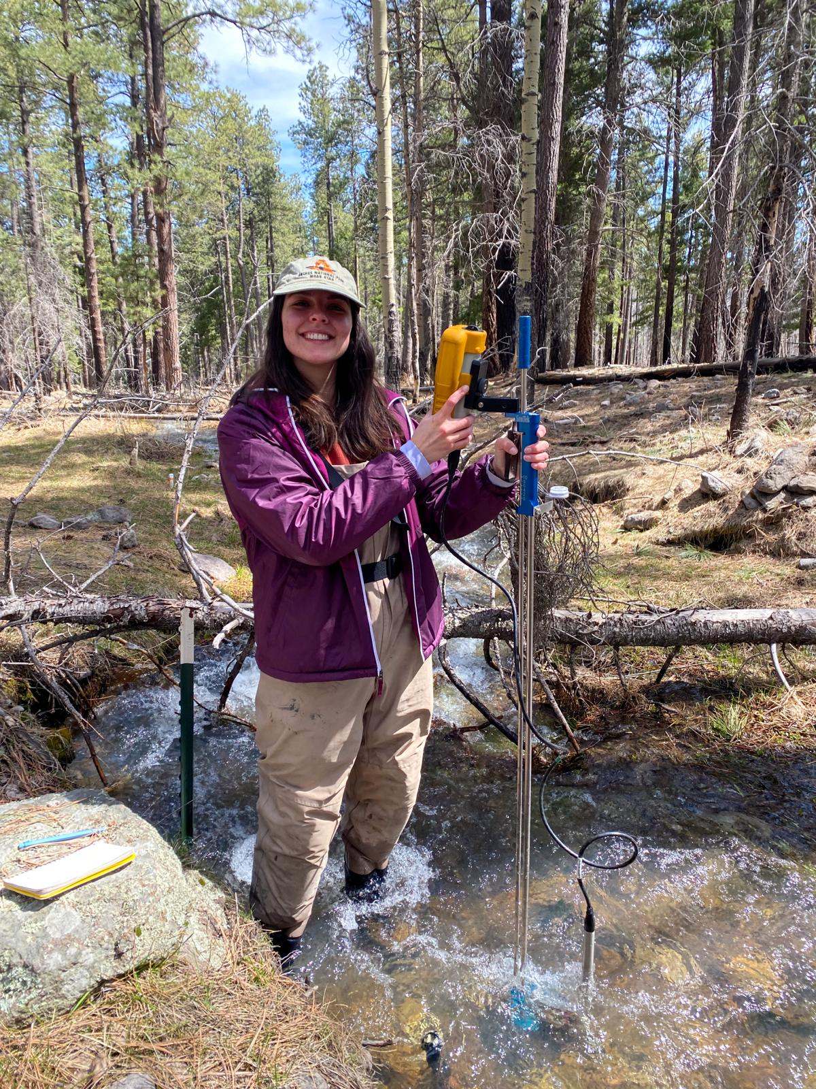

What about the other depositional effects? Vertical Velocity
Vz correlates much better with the closed basket data than with the open basket data
Closed Baskets have negative slope, open baskets have positive slope
12

Slide 14
Horizontal Velocity
Total sediment weight correlates better with horizontal velocity than vertical velocity? (both baskets!)
13

Slide 15
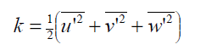
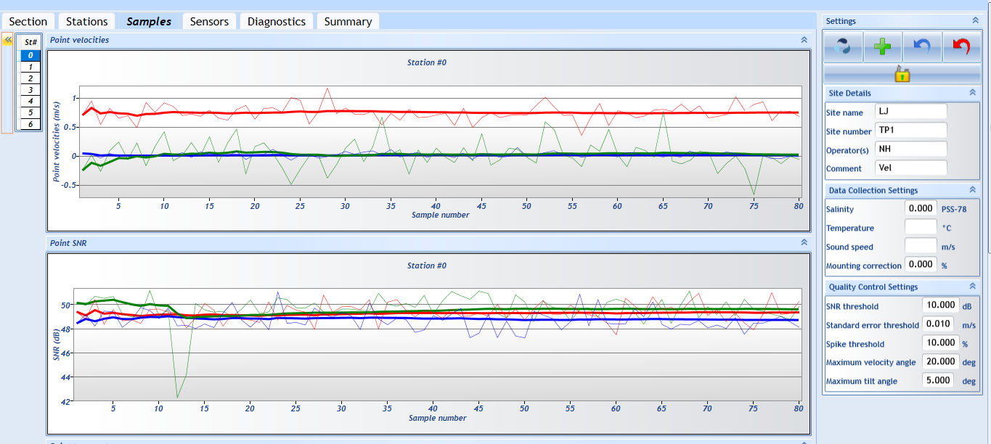
Accounting for turbulence: Turbulent Kinetic Energy (TKE)
Turbulence intensities obtained through ADV velocity measurements
14

Slide 16

Accounting for turbulence: Turbulent Kinetic Energy (TKE)
Best correlation with sediment weight I have gotten so far is with TKE in OPEN baskets???
15

Slide 17
Multivariable Regressions: Hyporheic Flux, Horizontal Velocity and TKE
Three Variable Regression: Hyporheic Flux, Horizontal Velocity and TKE
 | Closed Basket – Adjusted R2 | Open Basket – Adjusted R2
Coarse Sand | 0.1628 | 0.6992
Fine Sand | 0.4222* | 0.6545
Silt | 0.4923 | 0.5978
Clay | 0.4474 | 0.6258
* No p-value < 0.05, except the horizontal velocity p = 0.05 in the closed basket – fine sediment regression
Notes: No multi-collinearity between flux-TKE and flux-Hvelocity
But there is a slight correlation between horizontal velocity and TKE: VIF = 6.2058
16

Slide 18
Multivariable Regressions: Hyporheic Flux, Horizontal Velocity and TKE
Two Variable Regressions:
Hyporheic Flux and TKE
Hyporheic Flux and Horizontal Velocity
 | Closed R2 | Open R2
C. Sand | 0.1474 | 0.7366
F. Sand | 0.1452 | 0.6815
Silt | 0.1977 | 0.6458
Clay | 0.1577 | 0.6713
 | Closed R2 | Open R2
C. Sand | 0.204 | 0.596
F. Sand | 0.4864 | 0.4762
Silt | 0.545 | 0.4757
Clay | 0.5083 | 0.4832
Notes:
Closed baskets – No p<0.05
Open baskets – Only TKE p<0.05
Notes:
Closed baskets – Only H velocity p<0.05
Open baskets – Depends on the size
17

Slide 19


Next steps:
- Calculate settling velocities for different sizes from water column samples
- Add settling velocities to the regressions
- Regressions with vertical velocities instead of horizontal (despite Hvel correlating better)
- Average hyporheic fluxes over a longer period (perhaps during the falling limb, when things are depositing)
I am open to any ideas and suggestions ☺
18

